Slide 1

AGRI VISION – CROP PRODUCTION INTELLIGENCE PLATFORM
Presented by:
Ch.Sri Deepika(192424412)
K.Harshika(192473020)
V.Tejaswini(192424360)
Under the guidance by:
Dr. T kumargurubaran
Dr. Senthilvadivu S

Slide 2
ABSTRACT
Agriculture is a key pillar of India’s economy and national food security.
Agricultural production varies widely across regions, seasons, and crop categories.
AGRIVISION is a data-driven crop production intelligence platform built using Python.
The system analyzes historical crop production data from 1997 to 2015 across Indian states.
It applies geospatial mapping, temporal trend analysis, and comparative analytics.

Slide 3
PROBLEM STATEMENT
Agricultural production data is vast but underutilized due to lack of visualization
Regional production disparities are difficult to interpret using raw datasets
Seasonal and crop-wise trends remain hidden in traditional analysis
Policymakers lack integrated tools for data-driven agricultural planning
Absence of interactive systems limits strategic decision-making

Slide 4
OBJECTIVES
Analyze crop production patterns across Indian states
Visualize the geographical distribution of agricultural output
Identify long-term production trends and growth patterns
Compare crop production across seasons and crop categories
Identify high-performing regions and production hotspots
Provide actionable insights for agricultural planning and policy

Slide 5
DATASET DESCRIPTION
Total Records: 2,200+
Time Period: 1997 – 2015
Geographic Coverage: 32 Indian States & UTs
Crop Categories: 10+ (Cereals, Pulses, Fruits, Vegetables, Spices, etc.)
Source: Kaggle – Indian Crop Production Dataset
Type: Multivariate, Structured, Historical Dataset

Slide 6
METHODOLOGY
Data Collection
  Crop production dataset collected from Kaggle in CSV format
Data Preprocessing
  Cleaning missing and inconsistent values
  Standardizing crop names and state names
  Categorizing crops into major groups
Exploratory Data Analysis (EDA)
  Aggregation by State, Year, Season, and Crop Category
  Statistical summaries and trend identification
Visualization
Interactive charts, heatmaps, and maps using
Plotly
Temporal line charts and comparative bar graphs
Interpretation
Identification of production hotspots
Detection of seasonal and regional variations

Slide 7
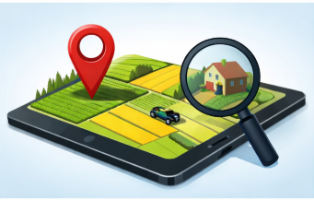
MODULE 1
GEOSPATIAL DISTRIBUTION ANALYSIS
Objective
  To visualize crop production distribution across Indian states and identify high-performing regions.
Process Steps
  Aggregate production data by state
  Rank states based on total production
  Plot interactive geographic maps
  Identify regional crop specialization
Output
  State-wise production maps
  Top producing states
  Geographic production hotspots

Slide 8
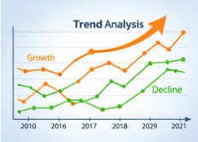
MODULE 2
TEMPORAL TRENDS & GROWTH ANALYSIS
Objective
  To analyze production trends and growth patterns over a 19-year period.
Process Steps
  Time-series aggregation by year
  Trend line visualization
  Year-over-year growth analysis
  Peak and volatility detection
Output
  Production trend charts
  Identification of peak production years
  Crop-wise growth patterns

Slide 9
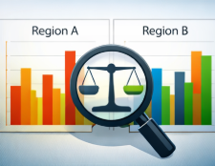
MODULE 3
COMPARATIVE VARIABLE ANALYSIS
Objective
  To compare crop production across seasons, regions, and crop categories.
Process Steps
  Cross-analysis of State × Season × Crop Category
  Comparative bar charts and heatmaps
  Multi-dimensional visualization
Output
  Seasonal production comparisons
  Crop category performance insights
  Cross-factor relationship analysis

Slide 10
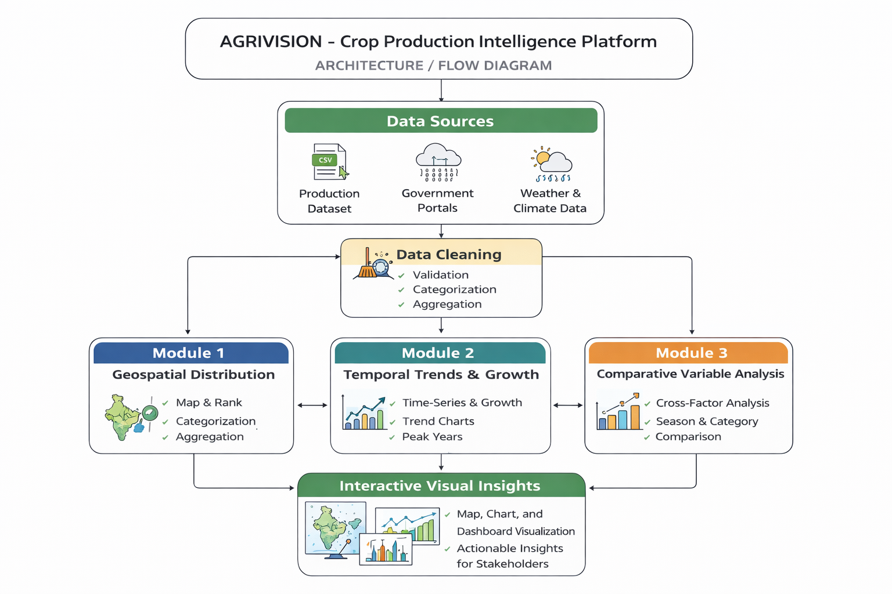
ARCHITECTURE

Slide 11
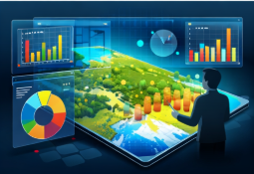
RESULTS
Identified top crop-producing states in India
Visualized regional production specialization
Detected long-term production growth trends
Revealed seasonal and crop-wise production variations
Enabled multi-dimensional agricultural insights

Slide 12
CONCLUSION
AGRIVISION integrates geospatial, temporal, and comparative analytics into a single platform.
The system converts complex agricultural datasets into clear and meaningful visual insights.
It supports data-driven agricultural planning and policy formulation.
The platform assists researchers in analyzing long-term production patterns.
AGRIVISION demonstrates the effectiveness of modern data visualization techniques in understanding India’s agricultural production landscape.

Slide 13
References
Han, J., Kamber, M., & Pei, J. (2022). Data Mining: Concepts and Techniques. Morgan Kaufmann.
James, G., Witten, D., Hastie, T., & Tibshirani, R. (2023). An Introduction to Statistical Learning. Springer.
Few, S. (2022). Show Me the Numbers: Designing Tables and Graphs to Enlighten. Analytics Press.
Cairo, A. (2023). The Functional Art: An Introduction to Information Graphics and Visualization. New Riders.
Provost, F., & Fawcett, T. (2022). Data Science for Business. O’Reilly Media.

Slide 14
FUTURE SCOPE
Integration of real-time agricultural data from sensors and government sources
Inclusion of climate and weather datasets for impact and risk analysis
Predictive crop production forecasting using machine learning techniques
Advanced interactive dashboards to support policymakers and planners
Integration of satellite and remote sensing data for large-scale monitoring
Expansion of the platform to national and global agricultural datasets

Slide 15
Thank You…!!!

